Slide 1

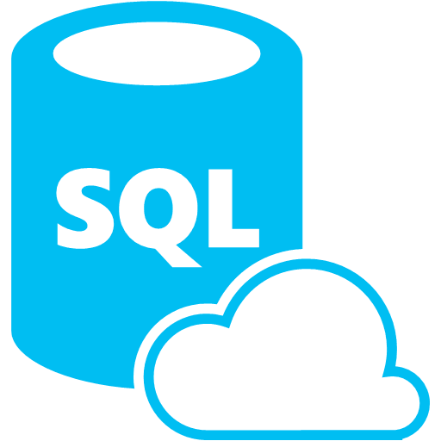

Synapse Analytics SQL Database Databricks
When to choose one?
Why it should be choosen?
Notes:
Technology democratization has led to make available the best features and the killer open-source frameworks to be available in almost all products in a line. Although the cloud provider used in one’s company takes priority, it makes it difficult to choose the best that fits for requirement. In this session, let me share my learnings, how our team analysed different frameworks for use cases. I hope it would help someone to choose the right data analytics tool for his need.

Slide 2




About Me
Dinesh Kumar P
Product Manager,
Analytics Squad.
https://www.linkedin.com/in/dinesh-kumar-prabakaran
Notes:
Myself currently working as a product manager, for the analytics and reports squad at Kissflow. Coming through 8+ years of the journey around data space, I have involved in implementing B2B SaaS products for Big Data, ETL, and Business Intelligence.

Slide 3
Agenda
1 Demystify, recommended scenarios for Database, Data warehouse, Data Lake.
2 Azure Synapse Analytics, Azure Databricks.
3 Common features but different in Synapse and Databricks of Azure.
4 When to use Azure Synapse, Azure Databricks?
5 My use case scenario at Kissflow.
6 What’s next?
Notes:
Wont be covering about each topic in detail. The aim of my talk is to share my knowledge about understanding the difference between tech stack, which look almost same in terms of features. And I expect that audience would know a little bit of basics like what is a Database, Data warehouse and so.

Slide 4
Database Data warehouse Data Lake
- Demystify.
- Best fit scenarios to choose one.
Notes:
This is a crazy and slightly confusing time in the data architecture space. More and more companies are shifting towards data lakes, yet the traditional data warehouse and database continues to provide value, as it has for decades. Now to add that, we have this increasingly popular lakehouse and delta lake concept. The concepts I discuss here will be common that would fit for deciding over data services in Azure as well.

Slide 5
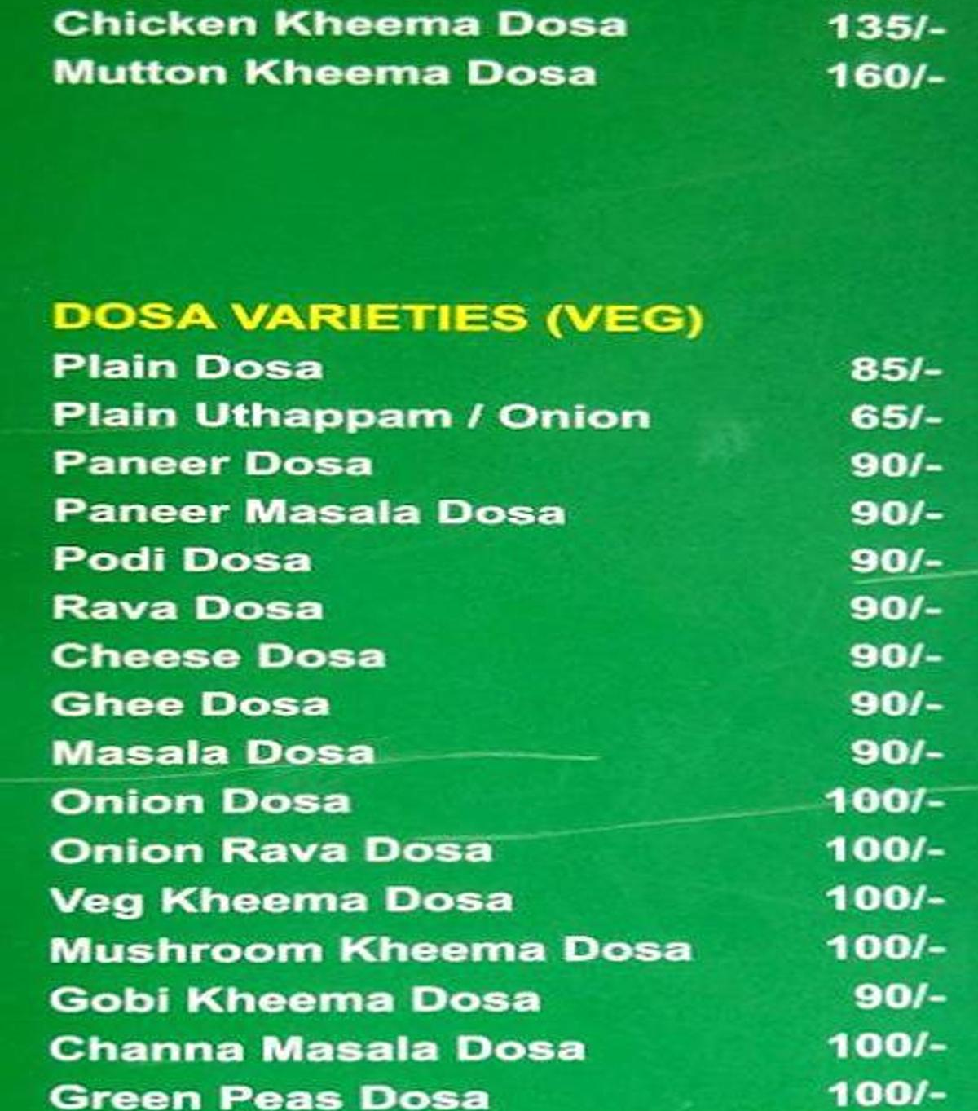
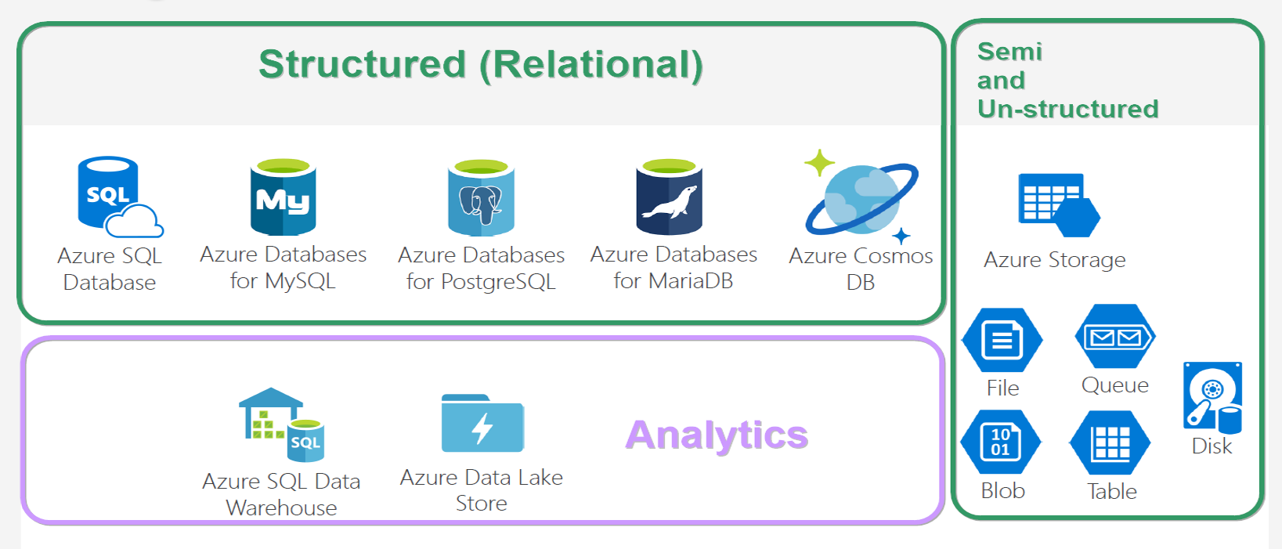
Database VARITES
Notes:
And looking at this, does both give same feeling? ☺

Slide 6
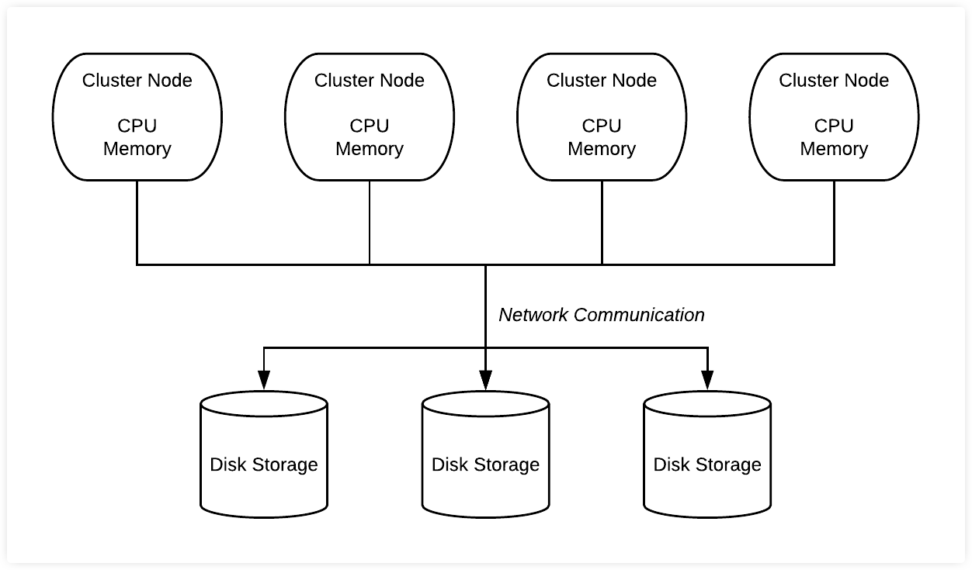
Database
* Co-location of Compute & Storage.
* Schema on Write.
* Recommended,
=> Structured data of less than a TB,
=> The purpose is for OLTP.
* Not recommended,
=> Ad-hoc analytics
=> More dependency in sharding.
Notes:
Size is not an issue as per a database’s doc. But generally not used for big data.
OLAP cubes are possible in RDBMS, but it need to be prepared before analytics. Which is what I mean for ad-hoc.

Slide 7
DBMS storage models
Notes:
NoSQL db – data storage model types –
* Document - Frequent schema changes with sub-tables need. (Mongo DB)
* Graph – Neo4j.
* Key-value - Redis.
* Column-oriented – Hbase, Cassandra.

Slide 8
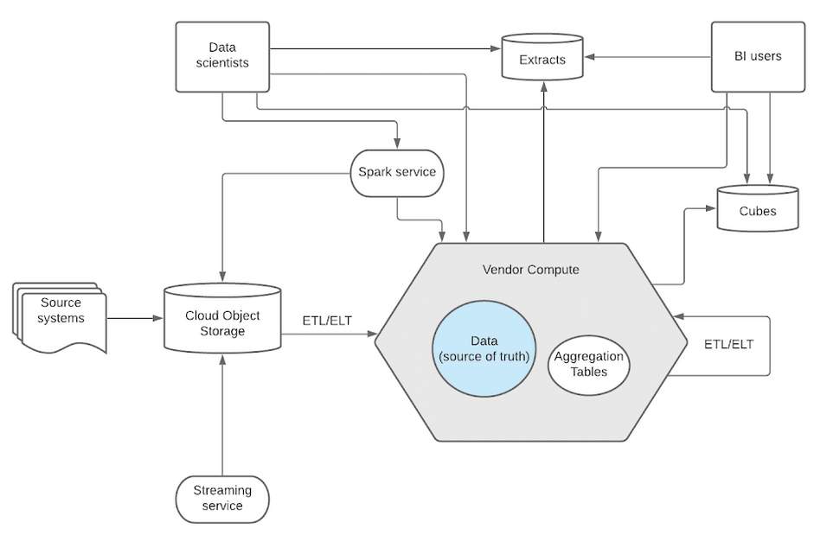
Data Warehouse
* Separation of Compute & Storage.
* Schema on Write.
* Recommended,
=> If you know metadata & schema/format of analytics to be done.
=> Decided that ML/AI not needed;
=> Expose out, allowing customers to analyse.
* Not recommended,
=> Unstructured data like image and video.
Notes:
* Data will be converted to proprietary software’s format. While leaving out, the vendor will export it to a common format like parquet or ORC.
* Snowflake has a data type called ‘BINARY’. Still not recommended. Rather you can decide to store the URL that points to that image/video stored in data lakes like S3.

Slide 9
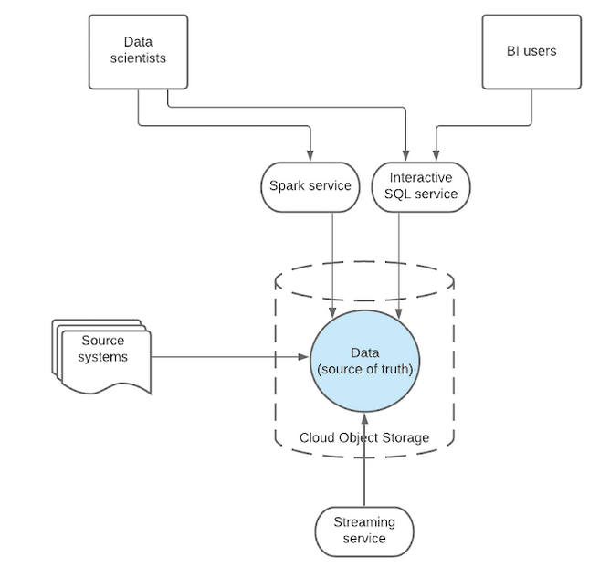
Data Lake
* Separation of Compute & Data.
* Schema on Read.
* Recommended when,
Have all types of data of any size.
Store now but have no plan about type of analysis to be run on it.
Internal analytics – dump all, play as and when you need.
Not recommended when,
=> Data, ready for analysis and users would create reports on it.
Notes:
* There wont be any conversion or copying to another system. Data relies in 1 single place and all external systems access over same data. So data democratization is good while using data lake.

Slide 10
Why different types – DB, DW, DL exist?
* Each type solves different problem statements.
* When NoSQL came, people talked that RDBMS will die soon. When Big Data talk was at its peak, it was spoken around that the whole DBMS will die.
* But still RDBMS was rocking, rocks now, and will rock in future too.
* Similar to Microservices vs Monolith based app development.

Slide 11
Azure Synapse Analytics Azure Databricks
What is does?
Common features but how its different in each?

Slide 12
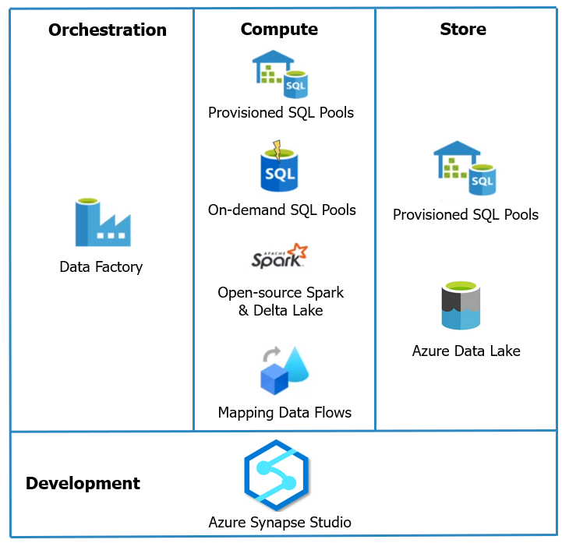
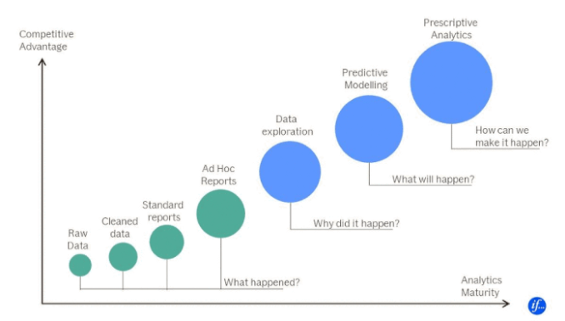
Azure Synapse Analytics
* Azure SQL Warehouse rebranded.
Notes:
* Background engineering improvised for better performance. Front end features are in beta as of now.

Slide 13
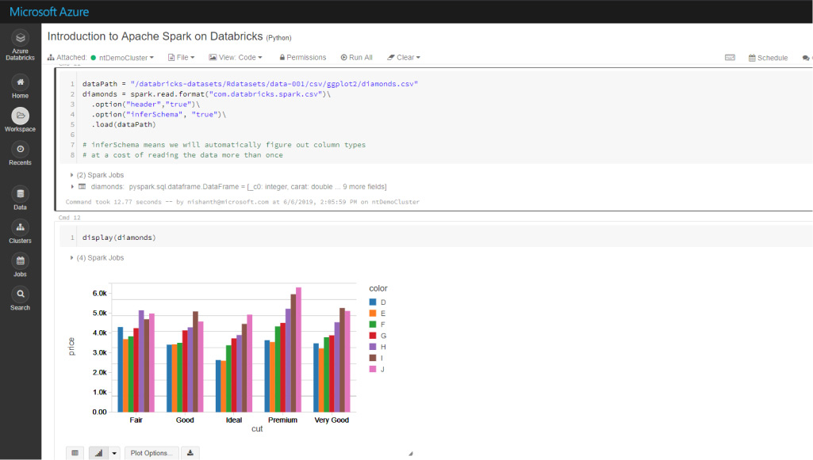
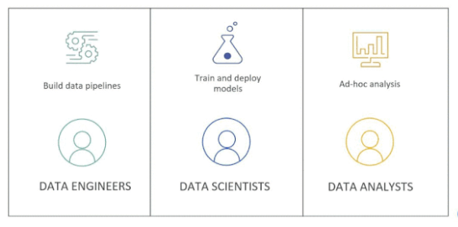
Azure databricks
* Data Lake.
* Hosted Spark environment - expanding with Delta Lake, MlFlow and SQL analytics.
* Best option for Machine Learning workloads for those with Microsoft tech stack.

Slide 14
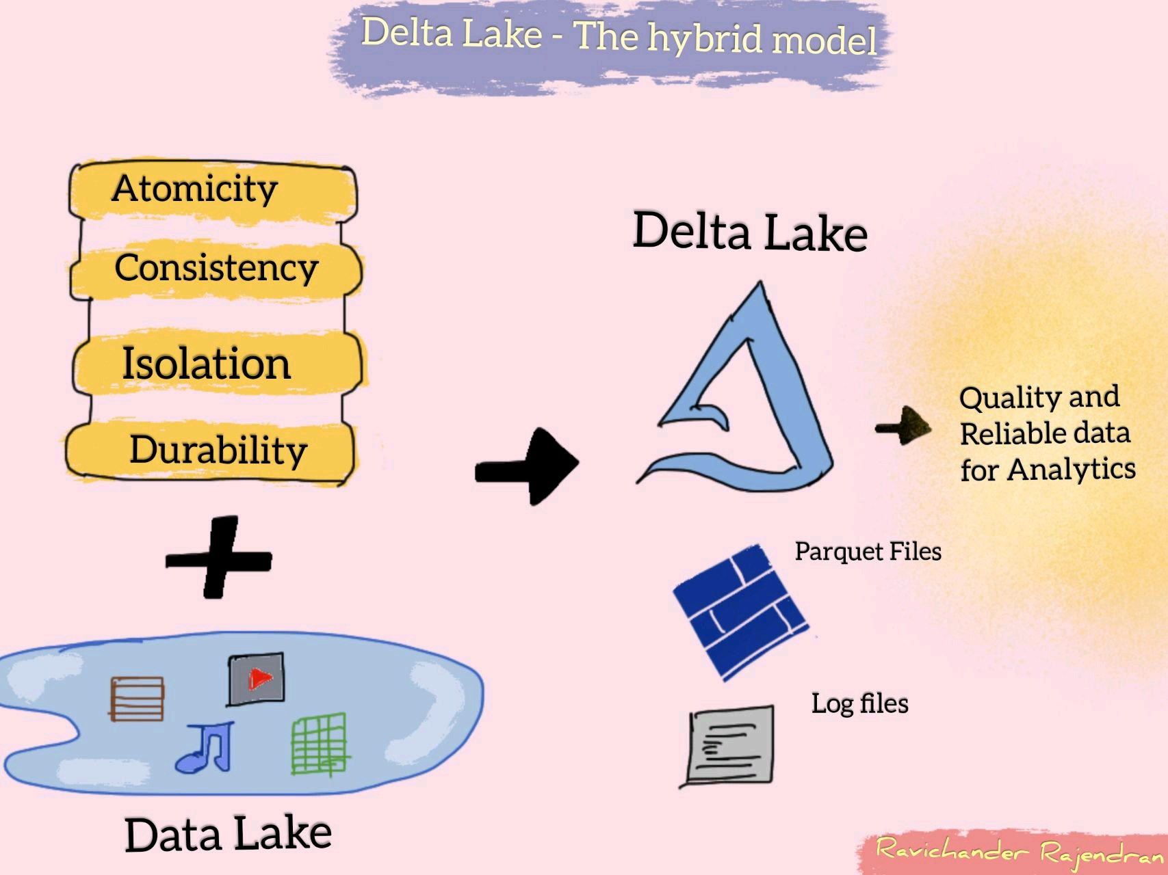

Delta lake – hybrid DATa format
Notes:
* Delta Lake that sits on top of data lake provides ACID transactions and unifies streaming and batch processing. It is also fully compatible with Spark APIs.
* In simple words, its about saving data as ‘Delta’ format and play with it.

Slide 15
Common features IN SYNAPSE & DATABRICKS
Common feature | Azure Synapse Analytics | Azure Databricks
Apache Spark & Delta Lake | Open-source. | Latest from Databricks.
Jupyter Notebooks | Nteract notebooks. | Databricks notebooks, real time co-authoring & automated versioning.
Access data from a Data Lake | Easier to query from sql scripts and notebooks. | Need to mount and then query.
Cloud hosted Python & SQL env | Good at Ad-hoc analysis. | Good at Mlflow.
Compute separate architecture | SQL on-demand pool. | Autoscaling pool.

Slide 16
When to use synapse and/or databricks
 | Scenario | Preferred
1 | Ad-hoc data lake discovery by code | Synapse and Databricks
2 | SQL analyses & Data warehousing | Synapse
3 | Self-service BI / Reporting | Synapse
4 | Same data, data scientists play via Spark & data analyst play via SQL. & BI use Power BI | Synapse
5 | More ML/AI development, GPU intensive tasks | Databricks
6 | Dependent tech is much on Delta lake format / Spark | Databricks
7 | In-built GIT based developer experience | Databricks
Notes:
Not going to repeat the points which I spoke earlier. I mean core features of Data warehouse / Data Lake / Data Lakehouse.

Slide 17
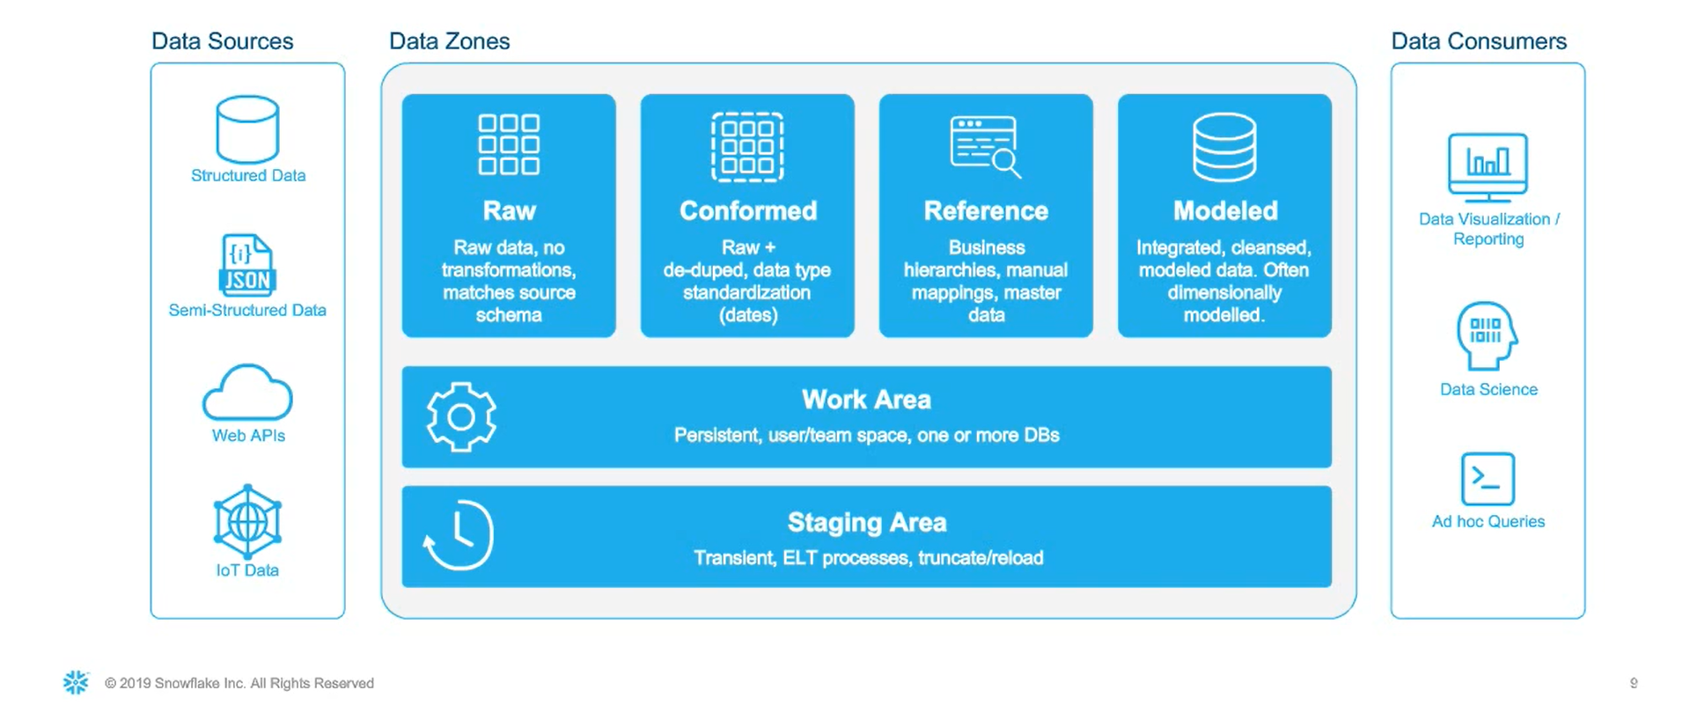
HYBRID Data architecture

Slide 18
USE CASE of KISSFLOW
- How we address advanced analytics need apart from general reporting.

Slide 19
use case of
* Kissflow is a pure SaaS product completely cloud managed.
* No Code product - Customers (business users) develop workflow apps by themself.
* For OLTP - MongoDB hosted in Atlas - 1 DB per customer. Earlier it was MySQL.
* Each customer will have their own schema (data model).
* Based on our product nature, per customer data won’t be huge.
* No separate analytics database as of now.
* Analysed Data Lake, Database and chosen to go with Data warehouse.
Notes:
MySQL was switched to Mongo for few reasons like – Not restricted over rigid schema, Better sharding, Multi instance need(Dev, staging, prod)
Data warehouse we were thinking to opt is Snowflake over Azure.

Slide 20
What Next?
After Database, Data warehouse & Data lake?

Slide 21
DATA LAKEHOUSE
* Sting together the best of both worlds – Data warehouse and Data lake.
* Implement data warehouse’ data structures & management features of data lakes.
* Single Data lakehouse for structured, semi-structured and unstructured acts as a
=> Multi-solution system,
=> Simplified data governance,
=> Cost-effective too.

Slide 22
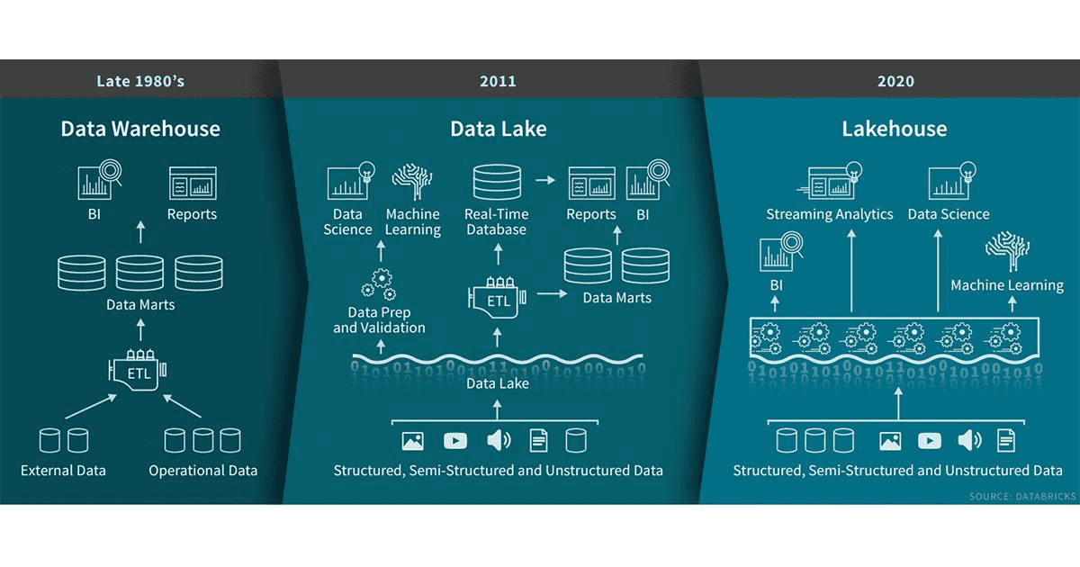

Slide 23
Useful LINKS to dive deep
* Post about “What is Data Lakehouse?”
* Blog post by Ivana Pejeva.
* Debate with proponents of each architecture at Datanova 2021 hosted by Cindi Howson.
* Blog - Launching Databricks at If by Valdas Maksimavicius.
* Video about choosing Data warehouse and/or Data lake.

Slide 24
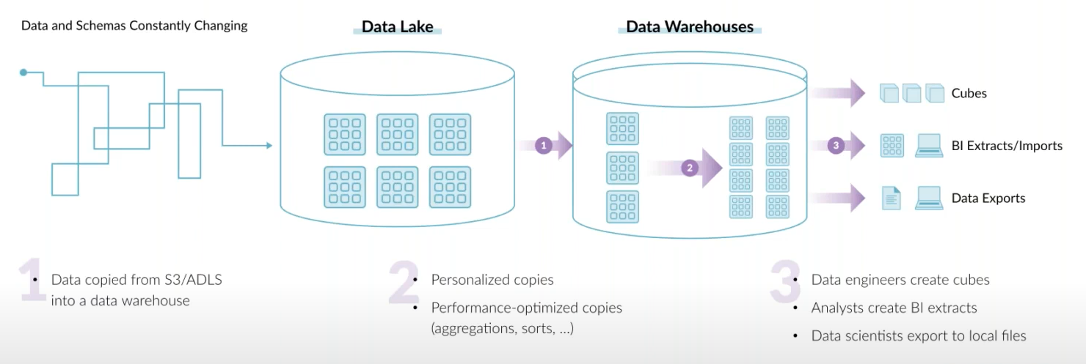
End goal of a data architecture – Allow USER to take SMART decisions
* Architect so that copying data gets lesser across teams.
* Define goal based on customers need. (Its not always ML or AI.)

Slide 25
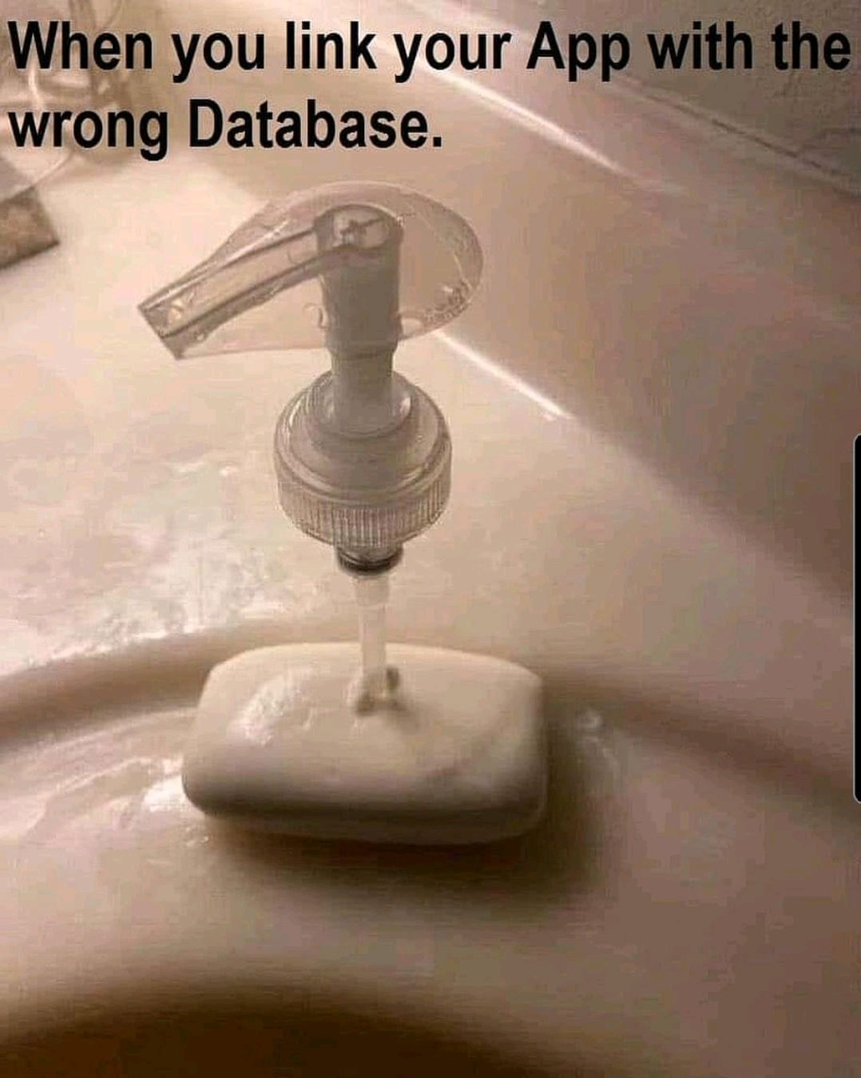
Before ending…
* Don’t choose a data tech, just because you / your team knew it.
* All the best for choosing right database for your need.

Slide 26
https://www.linkedin.com/in/dinesh-kumar-prabakaran
Thank you
Questions?

